Slide 1

3.2 Boolean Identities
11
The simpler that we can make a Boolean function, the smaller the circuit that will result.
  Simpler circuits are cheaper to build, consume less power, and run faster than complex circuits.
However, there are other criteria involved:
  How the circuit involved fits with other circuits in the machine, e.g., can common activities be factored out.
  General criteria such as providing redundancy, a safety margin of error, and others.
  Consistency with other machines in the same line.

Slide 2
3.2 Boolean Identities
11b
Still, we often want to reduce our Boolean functions to a simpler form.
  We can use Boolean identities (equations) for this.
  In a real-world situation, this would be accomplished with the help of a hardware compiler that would also enforce standards.

Slide 3
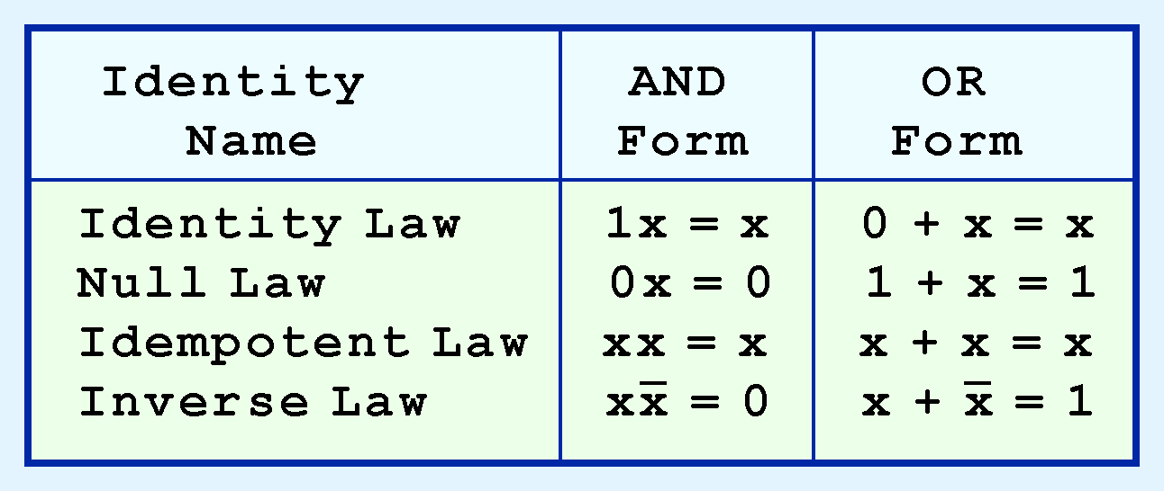
3.2 Boolean Identities
12
Most Boolean identities have an AND (product) form as well as an OR (sum) form.
The first group contains identities involving only one variable. They enable you to reduce the number of terms in an expression, and sometimes also the number of variables.

Slide 4
3.2 Boolean Identities
12a
The AND form and the OR form are duals.
The dual of a law is created as follows:
  Switch AND and OR.
  Switch 0 and 1.
  Check out the laws on the previous and following slides to make sure you can calculate the duals.
If a Boolean statement is valid (its truth table contains all TRUEs), its dual is valid also.
  This is different from ordinary arithmetic.
  It is a characteristic feature of Boolean algebra.

Slide 5
3.2 Boolean Identities
12b
Note that laws are good for variables and expressions
  The laws are expressed in terms of variables like X, Y and Z.
  You can substitute any Boolean expression in place of a variable.
Example
  The AND form of the identify law is 1x = x.
  That means that 1(x + y) = x + y, 1(x’) = x’, etc.

Slide 6
3.2 Boolean Identities
12a1
The identity law states that performing an operation with its identity does not affect the result.
  That is the definition of identity.
AND form: 1x = x
  The identity for AND is 1.
  Just as the identity for * in arithmetic is 1.
OR form: 0 + x = x
  The identity for OR is 0.
  Just as the identity for + in arithmetic is 0.
The identity law is the same as in arithmetic.

Slide 7
3.2 Boolean Identities
12a2
Identity law, AND form
1x = x
Explanation
  Since 1 = true, this means that: if x is true, then the value of “x and a true statement ” is the same as the value of x.
  In other words, if x is true, then “x and a true statement” is true; if x is false, then “x and a true statement” is false.
  This works because both inputs must be true to make the result of “and” true.

Slide 8
3.2 Boolean Identities
12b
Identity law, OR form
0 + x = x
Explanation
  Since 0 = false, this means that: if x is true, then the value of “x or a false statement ” is the same as the value of x.
  In other words, if x is true, then “x or a false statement” is false; if x is false, then “x or a false statement” is false.
  This works because only one statement needs to be true to make the result of “or” true.

Slide 9
3.2 Boolean Identities
12c
The null law states that use of the opposite operations’s identity “nullifies” a value.
AND form: 0x = 0
  Note that the x no longer appears on the right hand side.
OR form: 1 + x = 1
  Again, the x no longer appears on the right hand side.
The AND form is the same as in arithmetic. The OR form is different.

Slide 10
3.2 Boolean Identities
12c1
Null law, AND form
0x = 0
Explanation
  Since 0 = false, this means that if there is one false statement in a conjunction (series of ANDs), the result is false.

Slide 11
3.2 Boolean Identities
12d
Null law, OR form
1 + x = 1
Explanation
  Since 1 = true, this means that: if there is one true statement is a disjunction (series of ORs), the result is true.

Slide 12
3.2 Boolean Identities
12d1
The idempotent law states that if the two input values are the same, the output is the same as the input
  The term comes from the Latin words “idem”, meaning “same”, and “potent”, meaning “value”
  Note that the word is “idem”, not “item”
Note that the idempotent law does not have a carryover in arithmetic
AND form: xx = x
OR form: x + x = x

Slide 13
3.2 Boolean Identities
12e
Idempotent law, AND form
xx = x
Explanation
  If you “and” a variable with itself, you are not adding any new information, so the result (true or false) is the same as the input.

Slide 14
3.2 Boolean Identities
12f
Idempotent law, OR form
x + x = x
Explanation
  Similarly, if you “or” a variable with itself, you are not adding any new information, so the result (true or false) is the same as the input.

Slide 15
3.2 Boolean Identities
12f1
The inverse law states that if you perform an operation with a value and its complement, the result is the identity for the opposite operation
AND form: xx’ = 0
OR form: x + x’ = 1
This is different from arithmetic because in arithmetic we have different complements for + and *.

Slide 16
3.2 Boolean Identities
12g
Inverse law, AND form
xx’ = 0
Explanation
  The left hand side states “x and not x”. Those cannot both be true, so the result is false.

Slide 17
3.2 Boolean Identities
12h
Inverse law, OR form
x + x’ = 1
Explanation
  The left hand side states “x or not x”. One of those is always true, so the result is true.

Slide 18
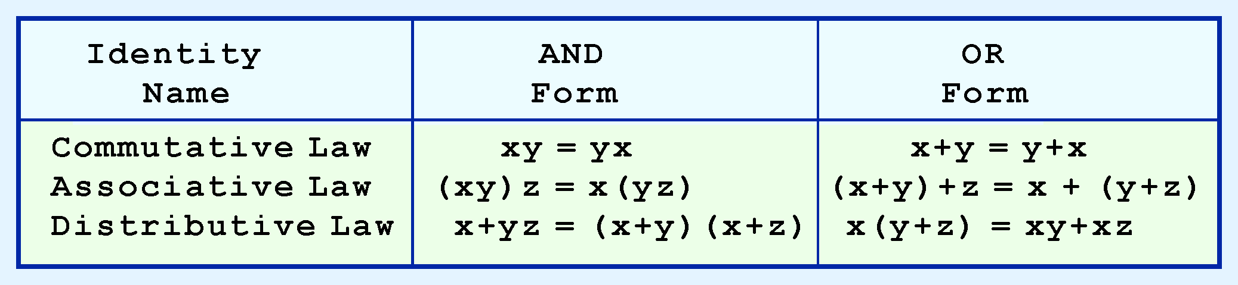
3.2 Boolean Identities
13
Our second group of Boolean identities are mostly parallel to the laws of arithmetic.
The distributive law, AND form, is the only one that does not occur in arithmetic.

Slide 19
3.2 Boolean Identities
13a1
The commutative law is the same as in arithmetic.
It states that the order of operands is immaterial.
AND form: xy = yx
OR form: x + y = y + x

Slide 20
3.2 Boolean Identities
13a2
The associative law is the same as in arithmetic.
It states that the grouping of operands with the same operator is immaterial.
AND form: (xy)z = x(yz)
OR form: (x + y) + z = x + (y + z)

Slide 21
3.2 Boolean Identities
13b
The distributive law explains how one operation can be “distributed” over the other.
In arithmetic we have only one distributive law, but in Boolean algebra we have two.
The distributive laws are named after the inner operation.
OR form: x(y + z) = xy + xz
AND form: x + yz = (x+y)(x+z)

Slide 22
3.2 Boolean Identities
13c
Distributive law, OR form
x(y + z) = xy + xz
This form resembles ordinary arithmetic.
Example
  If you have to take course X and either Y or Z to get your degree, then you can take either X and Y, or X and Z.

Slide 23
3.2 Boolean Identities
13d
Distributive law, AND form
x + yz = (x+y)(x+z)
This form does not have an equivalent in arithmetic.
Example
  If you have to take course X or both Y and Z, then it’s possible to say the following two things of every student.
  That person took X or Y.
  That person took X or Z.

Slide 24
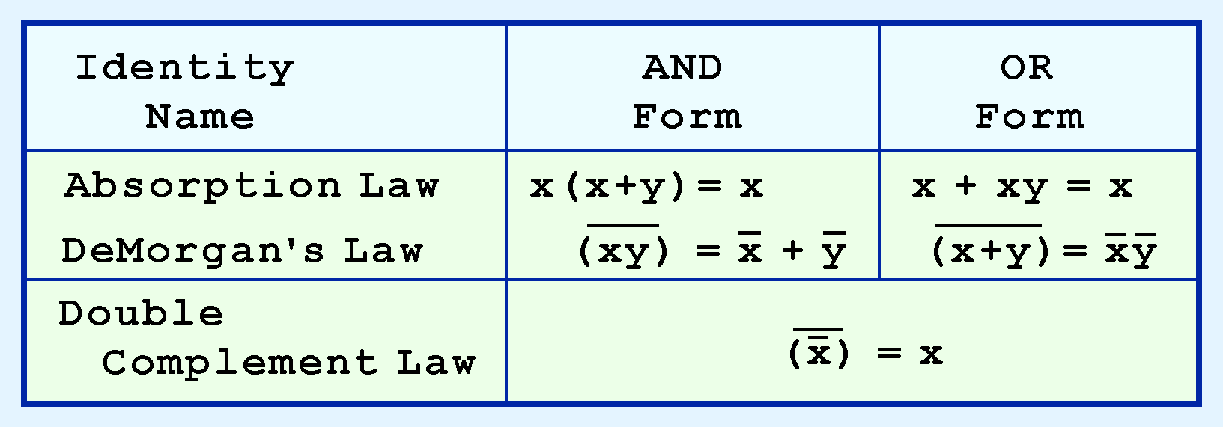
3.2 Boolean Identities
14
Our last group of identities is extremely useful in simplifying Boolean functions.
If you have studied set theory or formal logic, these laws may be familiar to you.

Slide 25
3.2 Boolean Identities
14b
Absorption law, AND form
x(x+y) = x
Explanation
  “x is true” is a stronger statement than “x or y is true”. So if both the stronger and the weaker statements are true, then we only need to state the stronger one.

Slide 26
3.2 Boolean Identities
14c
Absorption law, OR form
x + xy = x
Explanation
  The cases where “x and y” is true are a subset of the cases where x is true. Therefore the “x and y” term doesn’t add anything to the disjunction of the two terms. Adding a subset of x to x just gives x again.

Slide 27
3.2 Boolean Identities
14c1
DeMorgan’s law. AND form
-(xy) = -x + -y
Explanation
  If “x and y” is false, then one or the other must be false.

Slide 28
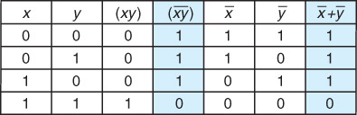
3.2 Boolean Identities
14c2
This truth table shows the validity of the AND version of DeMorgan’s Law.
The shaded columns show the values of the left- and right-hand sides, and they are identical.

Slide 29
3.2 Boolean Identities
14c1
DeMorgan’s law. OR form
-(x + y) = (-x)(-y)
Explanation
  If “x or y” is false, then the only way that can happen is if both x is false and y is false.

Slide 30
3.2 Boolean Identities
14d
Double complement law
x’’ = x
Explanation
  If the complement of an expression is true, the expression must be false. So if x’’ is true, then x’ is false, which means x is true. Similarly if x’’ if false.
This law is useful because we can use DeMorgan’s Laws to take the complement of an expression.

Slide 31
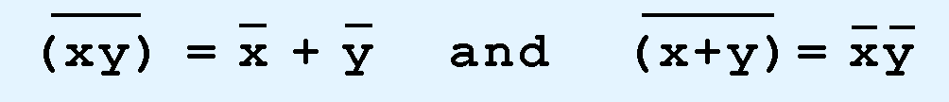
3.2 Boolean Identities
16
Sometimes it is more economical to build a circuit using the complement of a function (and complementing its result) than it is to implement the function directly.
DeMorgan’s law is an easy way to find the complement of a Boolean function. You may have to apply them multiple times.
Recall that DeMorgan’s laws are:

Slide 32
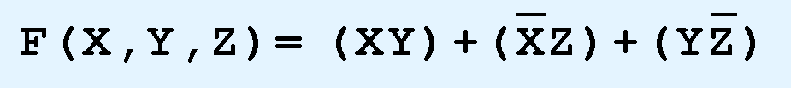
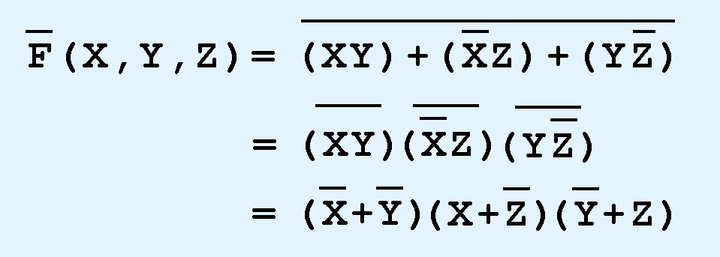
3.2 Boolean Identities
17
Like many of the laws, DeMorgan’s laws can be extended to any number of variables.
To do so, replace each variable by its complement and change all ANDs to ORs and all ORs to ANDs.
Thus, the complement of:
is:

Slide 33
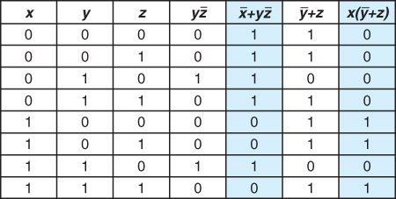
3.2 Boolean Identities
17c
This truth table gives an example showing that a function and its complement have opposite values.

Slide 34

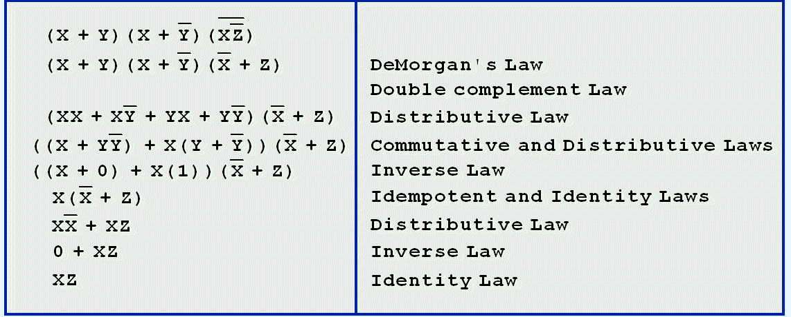
3.2 Boolean Identities
17d
Example: Simplify the following function:

Slide 35
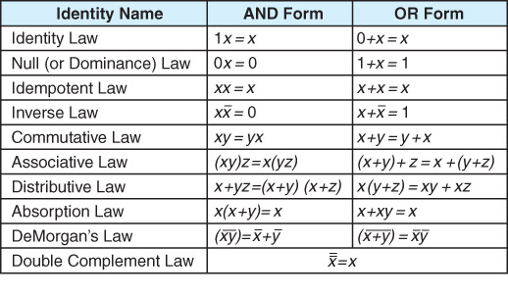
3.2 Boolean Identities
17e
Convenient summary sheet of Boolean identities

